Slide 1


Výukový materiál
zpracovaný v rámci projektu
Registrační číslo projektu:
CZ.1.07/1.5.00/34.0199
Označení:
VY_32_INOVACE_ANJ_VL_3_15
Sada: 3
Ověření ve výuce:
18. 11. 2013
Třída:
1. L
Datum:
20. 10. 2013

Slide 2
Minulý čas průběhový
Past Continuous
Předmět:
Anglický jazyk
Tematická oblast:
Grammar & Syntax
Ročník:
1. ročník
Anotace:
Základní pravidla pro tvoření minulého času průběhového, zásady a příklady jeho použití
Jméno autora (vč. titulu):
Mgr. Radka Volfová
Škola – adresa:
OA a VOŠE Tábor, Jiráskova 1615

Slide 3
Past Continuous - affirmative
Was/were + present participle
singular | plural
I was playing | we were playing
you were playing | you were playing
he was playing | they were playing

Slide 4
Past Continuous - negative
Wasn´t/weren´t + present participle
singular | plural
I wasn´t playing | we weren´t playing
you weren´t playing | you weren´t playing
he wasn´t playing | they weren´t playing

Slide 5
Past Continuous - question
Was/wasn´t/were/weren´t + subject + present participle
singular | plural
Was I playing? | Were we playing?
Were you playing? | Were you playing?
Was he playing? | Were they playing?

Slide 6
We use Past Continuous
to describe a past action over a period of time
They were working in the garden all day.
for an action that we were in the middle of
This time yesterday the cook was working.
to show two past actions happening at the same time
I was reading a book and Martin was watching TV.
While I was washing up, Martin was reading newspaper.

Slide 7
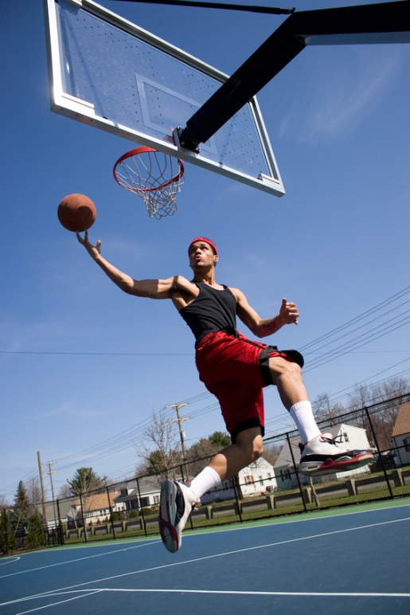
Exercise
Look at the picture. You saw Jim in the playground yesterday afternoon. What was he doing? Write affirmative and negative sentences.
(wear / red shorts)………………………………….
(go / to work)……………………………………….
(play / basketball)…………………………………..
(eat / a hamburger)…………………………………
(ride / a bike)………………………………………..
(carry / a bag)……………………………………….

Slide 8
Exercise - solution
Look at the picture. You saw Jim in the playground yesterday afternoon. What was he doing? Write affirmative and negative sentences.
He was wearing red shorts.
He wasn´t going to work.
He was playing basketball.
He wasn´t eating a hamburger.
He wasn´t riding a bike.
He wasn´t carrying a bag.

Slide 9
Exercise
Complete the conversation. Put in the Past Continuous forms.
Jessica: ………. (I / look) for you, Vicky. I´m afraid I´ve broken this dish.
Vicky: Oh no! What ………. (you / do)?
Jessica: ………. (I / take) it into the kitchen. I bumped into Emma. ………. ( she / come) out just as ……….. ( I / go) in.
Vicky: I expect it was your fault. ………. ( you / not / look) where ………. ( you / go).
Jessica: Sorry. I´ll buy you another one as soon as I have some money.

Slide 10
Exercise - solution
Complete the conversation. Put in the Past Continuous forms.
Jessica: I was looking for you, Vicky. I´m afraid I´ve broken this dish.
Vicky: Oh no! What were you doing?
Jessica: I was taking it into the kitchen. I bumped into Emma. She was coming out just as I was going in.
Vicky: I expect it was your fault. You weren´t looking where you were going.
Jessica: Sorry. I´ll buy you another one as soon as I have some money.

Slide 11
Seznam použité literatury a pramenů
Murphy, R., Essential Grammar in Use, Cambridge University Press 2007
Murphy, R., English Grammar in Use, Cambridge University Press 2004
Eastwood, J., Oxford Practice Grammar Intermediate, Oxford University Press 2006
obrázky – kliparty sady Microsoft Office

