Slide 1


Výukový materiál
zpracovaný v rámci projektu
Registrační číslo projektu:
CZ.1.07/1.5.00/34.0199
Označení:
VY_32_INOVACE_ANJ_VL_3_12
Sada: 3
Ověření ve výuce:
1. 10. 2013
Třída:
1. B
Datum:
2. 9. 2013

Slide 2
Přítomný čas průběhový
Present Continuous
Předmět:
Anglický jazyk
Tematická oblast:
Grammar & Syntax
Ročník:
1. ročník
Anotace:
Základní pravidla pro tvoření přítomného času průběhového, zásady a příklady jeho použití
Jméno autora (vč. titulu):
Mgr. Radka Volfová
Škola – adresa:
OA a VOŠE Tábor, Jiráskova 1615

Slide 3
Present Continuous - affirmative
Am / is / are + present participle
singular | plural
I am playing | we are playing
you are playing | you are playing
he is playing | they are playing

Slide 4
Present Continuous - negative
Am not / isn´t / aren´t + present participle
singular | plural
I am not playing | we aren´t playing
you aren´t playing | you aren´t playing
he isn´t playing | they aren´t playing

Slide 5
Present Continuous - question
Am / is / isn´t/ are / aren´t + subject + present participle
singular | plural
Am I playing? | Are we playing?
Are you playing? | Are you playing?
Is he playing? | Are they playing?

Slide 6
We use Present Continuous
for something that is happening now
It´s raining at the moment.
I´m watching this programme.
for a routine or situation that we see as temporary (for a short time)
She is working at a sport shop for six weeks.
At the moment he is living with his sister.
to say that something will or will not happen in the near future
I am going to the party tonight.
to say that something irritating or shocking often happens
  He is always coming late.
  You are always losing your keys.

Slide 7
Signal words
now
right now
just now
at the moment
today
this year
this week
nowadays
at present

Slide 8
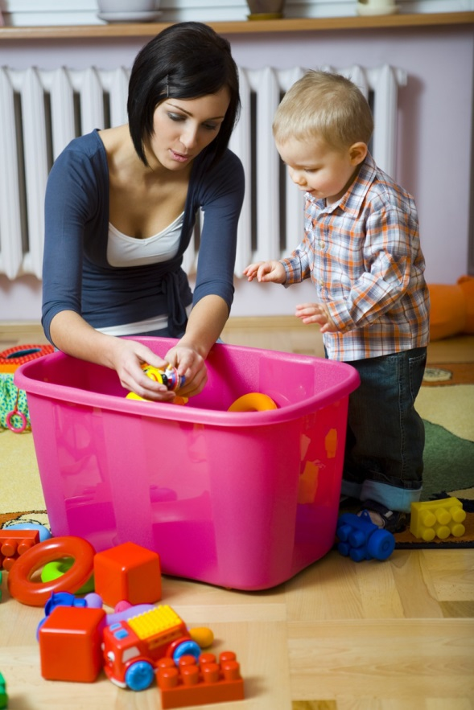
Exercise
Look at the picture. You can see Tim with his mum. What are they doing? Write affirmative and negative sentences.
(wear / blue jeans)………………………………………
(eat / a hamburger)…………………………………….
(play / with toys)……………………………………….
(stand / next to the box)……………………………….
(sit / the chair)……………………………………………..
(enjoy / the game)……………………………………….
( go / to school) …………………………………………

Slide 9
Exercise - solution
Look at the picture. You can see Tim with his mum. What are they doing? Write affirmative and negative sentences.
Tim is wearing blue jeans.
He isn´t eating a hamburger.
Tim´s mum is playing with toys.
Tim is standing next to the box.
She isn´t sitting on the chair.
They are enjoying the game.
They aren´t going to school.

Slide 10
Exercise
Put the verb into the correct Present Continuous form.
Please don´t make so much noise. I ………. to work. try
Let´s go out now. It ……… any more. rain
You can turn off the radio. I ………. to it. listen
„You ………. hard today.“ „Yes, I have a lot to do.“ work
Paul and Sally have had an argument. They ………. to each other. speak
I ………. tired. I need a rest. get
I ………. for Christine. Do you know where she is? look

Slide 11
Exercise - solution
Put the verb into the correct Present Continuous form.
Please don´t make so much noise. I am trying to work.
Let´s go out now. It isn´t raining any more.
You can turn off the radio. I am not listening to it.
„You are working hard today.“ „Yes, I have a lot to do.“
Paul and Sally have had an argument. They aren´t speaking to each other.
I am getting tired. I need a rest.
I am looking for Christine. Do you know where she is?

Slide 12
Seznam použité literatury a pramenů
Murphy, R., Essential Grammar in Use, Cambridge University Press 2007
Murphy, R., English Grammar in Use, Cambridge University Press 2004
Eastwood, J., Oxford Practice Grammar Intermediate, Oxford University Press 2006
obrázky – kliparty sady Microsoft Office

